Slide 1
Lecture 6 Variance and standard deviation Cumulative distributions The normal distribution

Slide 2
Review
Percentiles
Range and IQR
The five number summary and boxplot

Slide 3
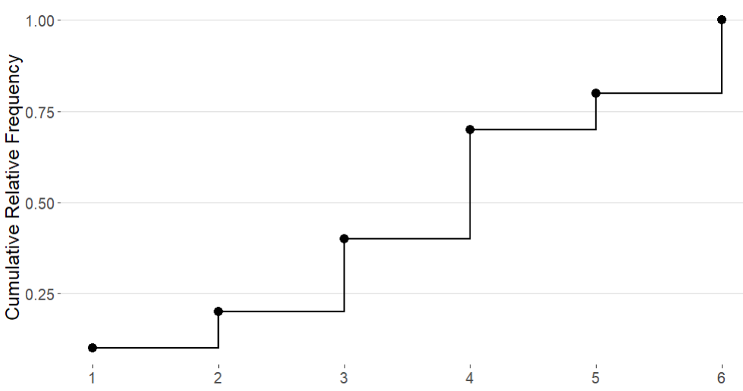
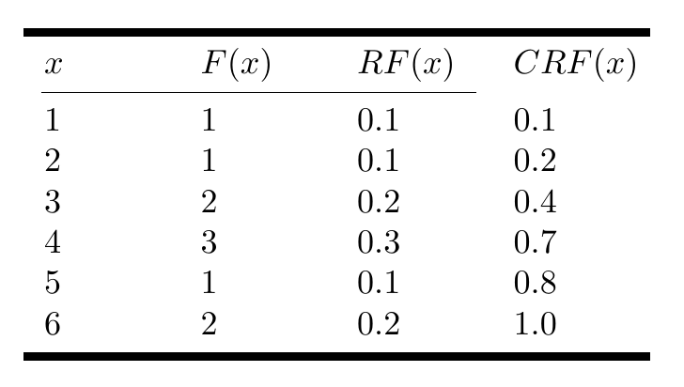
Cumulative Distributions
A cumulative distribution shows the relationship between the value of a variable and the cumulative relative frequency
We represent the cumulative distribution using a step function
Data = 1,2,3,3,4,4,4,5,6,6

Slide 4
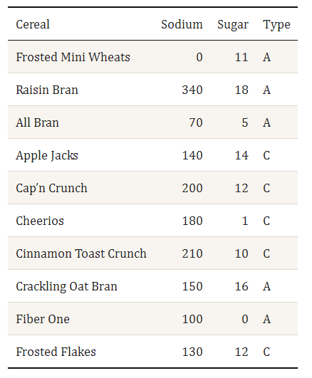
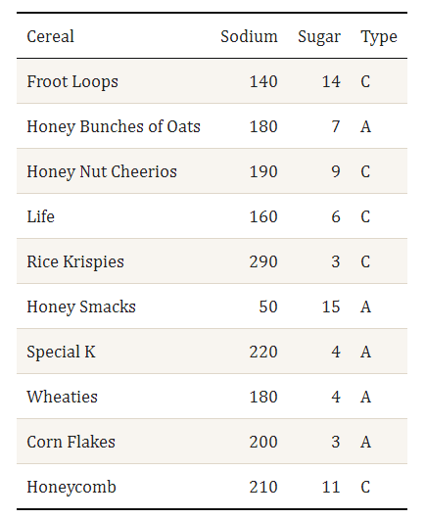

Slide 5
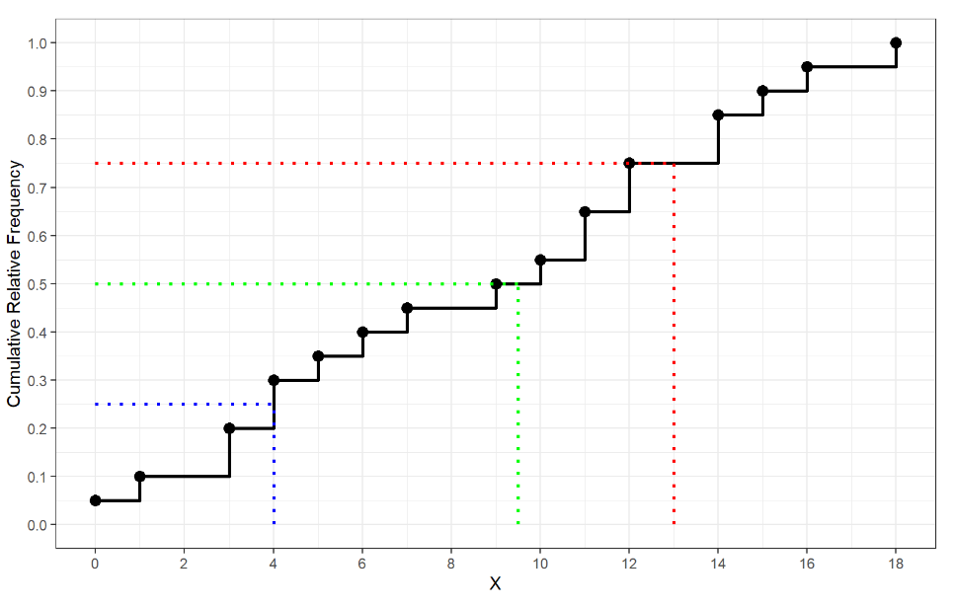

Finding Percentiles from Cumulative Distributions
lower half middle upper half
Data = 0, 1, 3, 3, 4, 4, 5, 6, 7, 9, 10,11,11,12,12,14,14,15,16,18
Q1 $= \frac{4+4}{2}=4$
Q2 $=\frac{9+10}{2}=9.5$
Q3 $= \frac{12+14}{2}=13$
What is the IQR?
IQR $=13 −4=8$

Slide 6
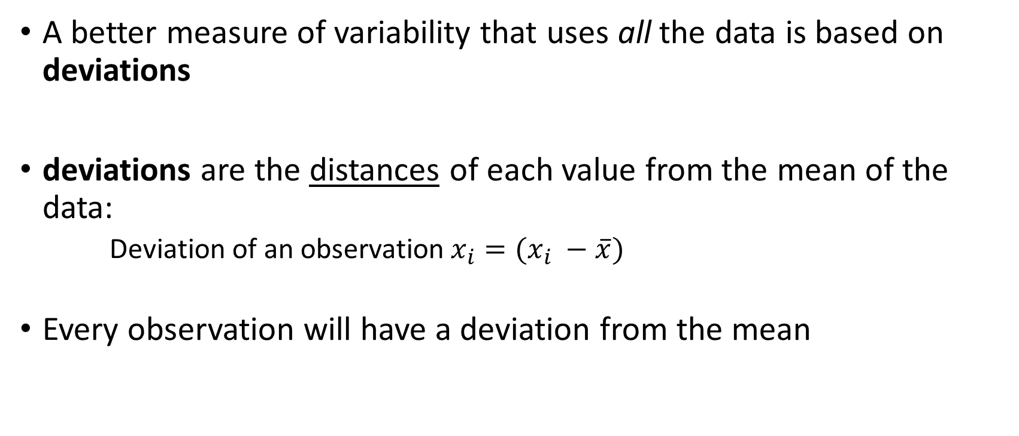
Measures of Spread: Deviation
A better measure of variability that uses all the data is based on deviations
deviations are the distances of each value from the mean of the data:
Deviation of an observation$x_{i}=(x_{i} −\overline{x})$
Every observation will have a deviation from the mean

Slide 7
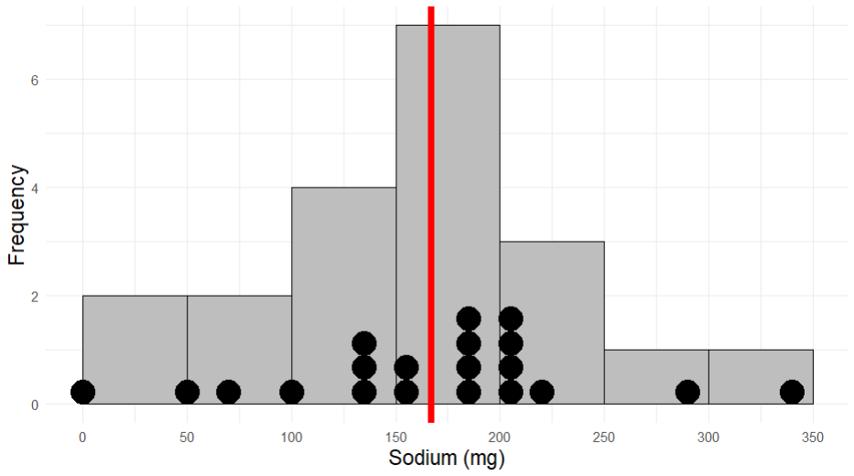


Frosted Mini Wheats = 0 (mg)
Mean = 167 (mg)
Rasin Bran = 340 (mg)
$$0 −167=−167$$
$$340 −167=173$$

Slide 8
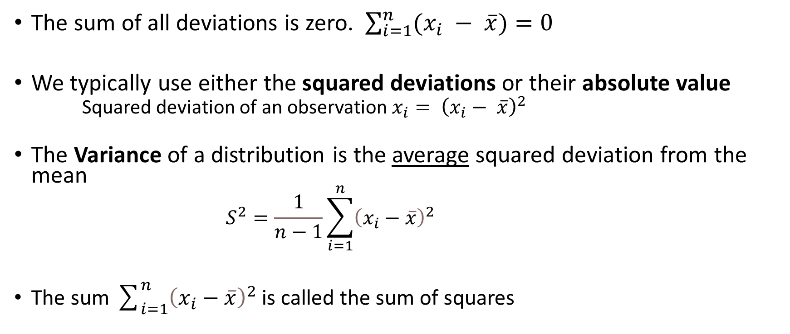
Measures of Spread: Variance
The sum of all deviations is zero. $\sum_{i=1}^{n}{(x_{i} − \overline{x})}=0$
We typically use either the squared deviations or their absolute value
Squared deviation of an observation $x_{i}= {\left(x_{i}− \overline{x}\right)}^{2}$
The Variance of a distribution is the average squared deviation from the mean
$$S^{2}=\frac{1}{n−1}\sum_{i=1}^{n}{{\left(x_{i}−\overline{x}\right)}^{2}}$$
The sum $\sum_{i=1}^{n}{{\left(x_{i}−\overline{x}\right)}^{2}}$ is called the sum of squares

Slide 9
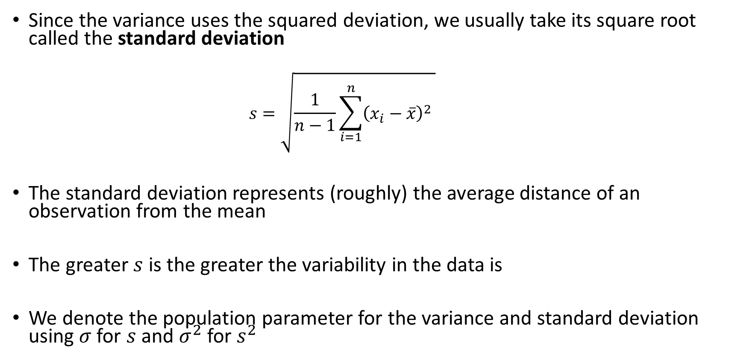
Measures of Spread: Standard Deviation
Since the variance uses the squared deviation, we usually take its square root called the standard deviation
$$s=\sqrt{\frac{1}{n−1}\sum_{i=1}^{n}{{\left(x_{i}−\overline{x}\right)}^{2}} }$$
The standard deviation represents (roughly) the average distance of an observation from the mean
The greater $s$ is the greater the variability in the data is
We denote the population parameter for the variance and standard deviation using $σ$ for $s$ and $σ^{2}$ for $s^{2}$

Slide 10

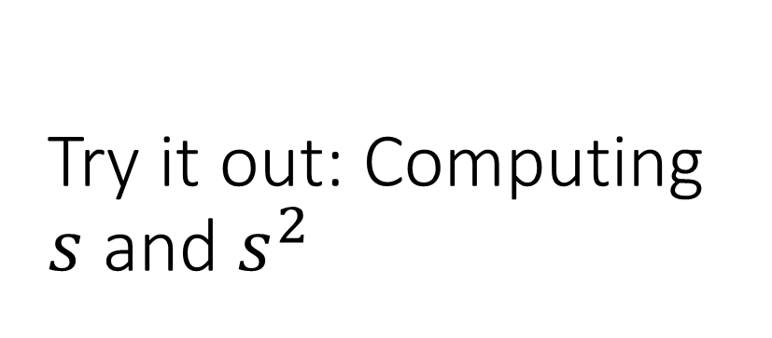
Try it out: Computing $s$ and $s^{2}$
Consider the following sample of 5 observations of the height of colleges students at the University of Idaho
Data = 61,62,62,68,75
Mean = 65.6
What if we observe another student who has a height of $x=92$ inches. How does including this observation change our estimate $s$

Slide 11
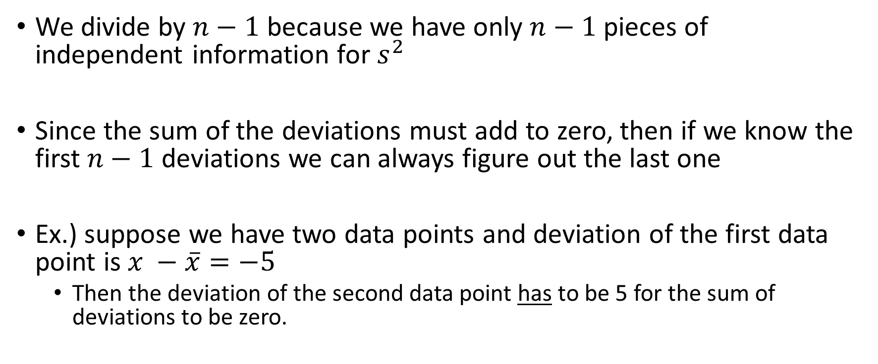

Why divide by $n−1$ ?
We divide by $n−1$ because we have only $n−1$pieces of independent information for $s^{2}$
Since the sum of the deviations must add to zero, then if we know the first $n−1$ deviations we can always figure out the last one
Ex.) suppose we have two data points and deviation of the first data point is $x −\overline{x}=−5$
Then the deviation of the second data point has to be 5 for the sum of deviations to be zero.

Slide 12
End of Material For Exam 1

